Slide 1
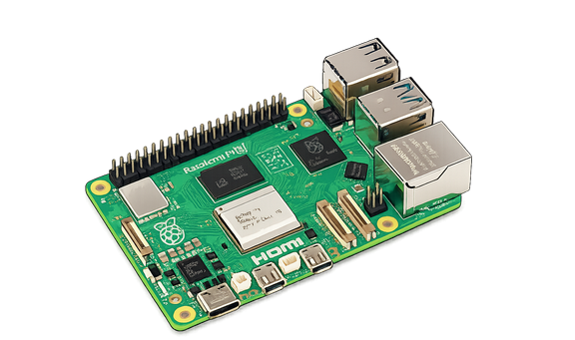
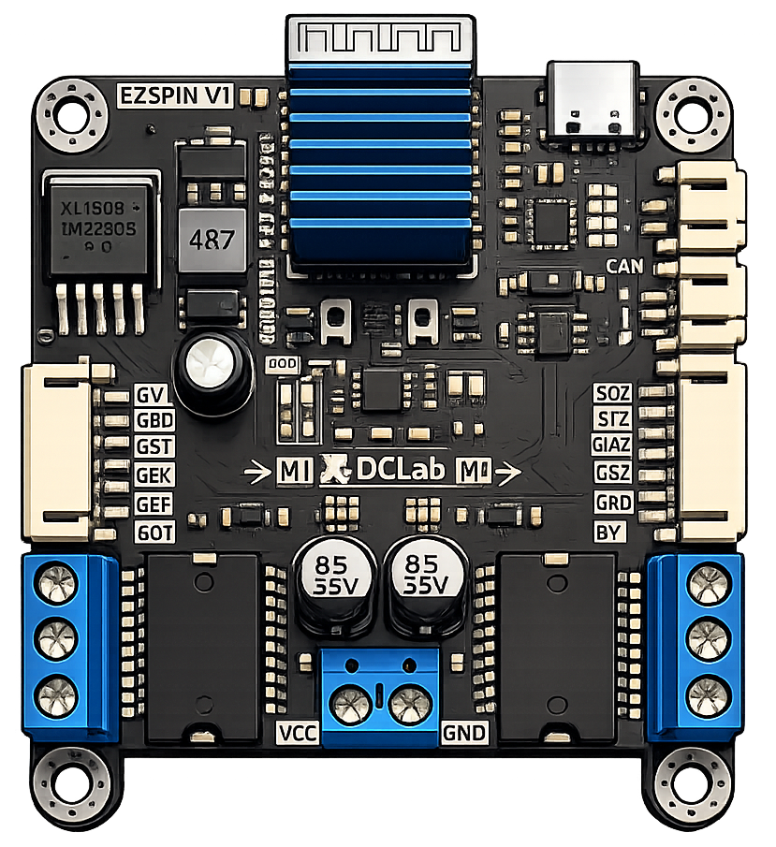
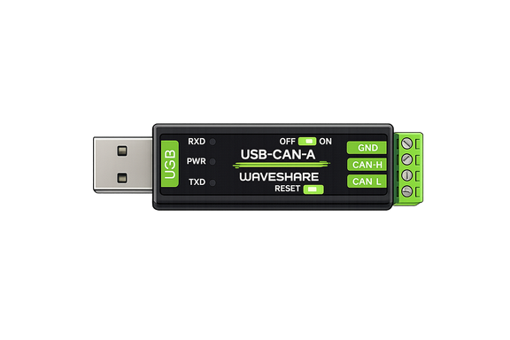
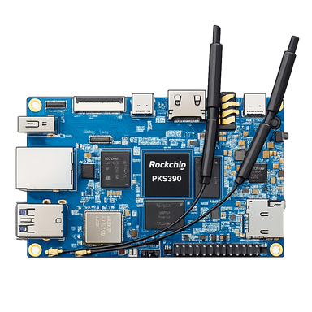
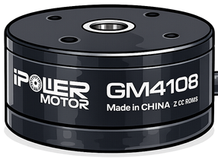
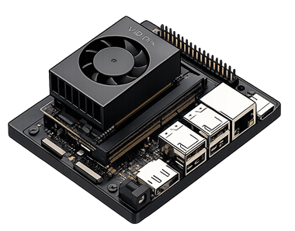
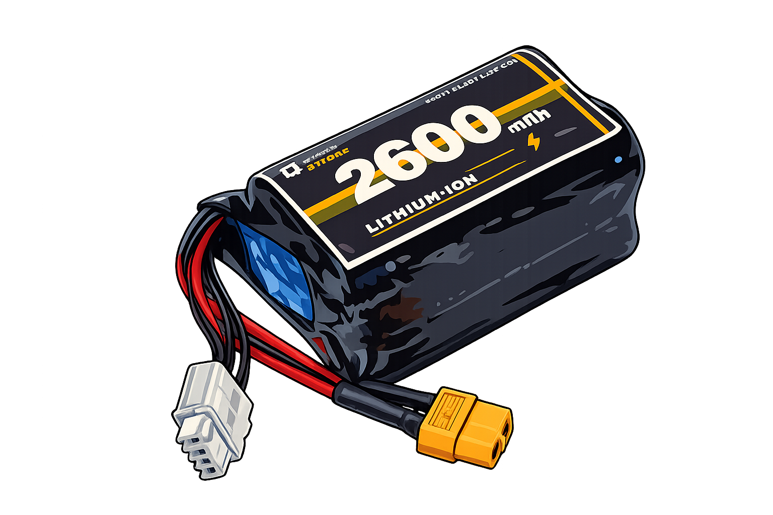
EZSPIN Driver (Custom BLDC driver)
Communicate with Embedded devices via
CAN Protocol
GM4108 Gimbal Motor with Magnetic Encoder
CAN H
Raspberry Pi 5
CAN L
5V
5V
GND
GND
CS
CS
SI
SI
SO
SO
U
U
V
V
W
W
Orange pi 5B
Lithium-ion Battery 3S (DIY Battery)
IMU Sensor On Board
Jetson Orin Nano

Slide 2

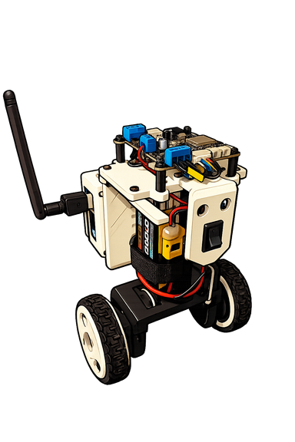
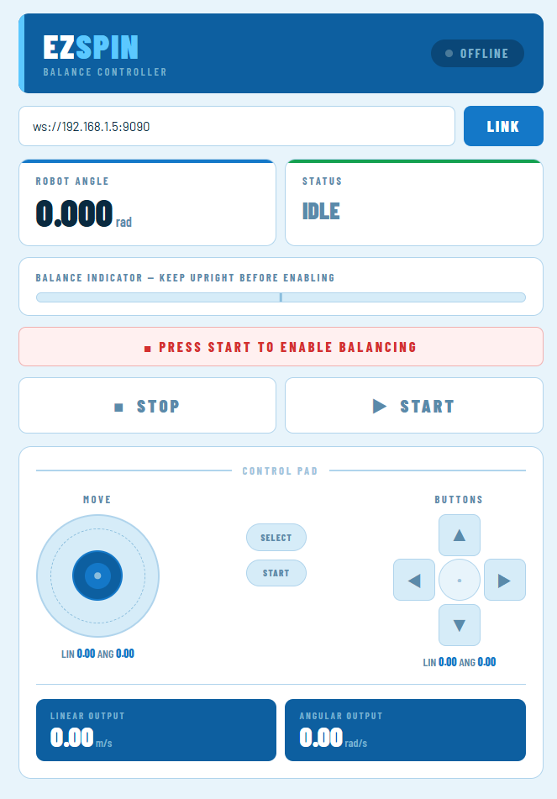
EZSPIN Driver
Measurement Roll angle from IMU sensor
Orange Pi 5B
Desired Velocity
Velocity Error
PID
Low pass Filter
-
Roll Error
PID
Desired Torque
Desired Roll
+
-
+
Measurement Velocity from Magnetic encoder
Web UI design for controller a robot movement

